Slide 1
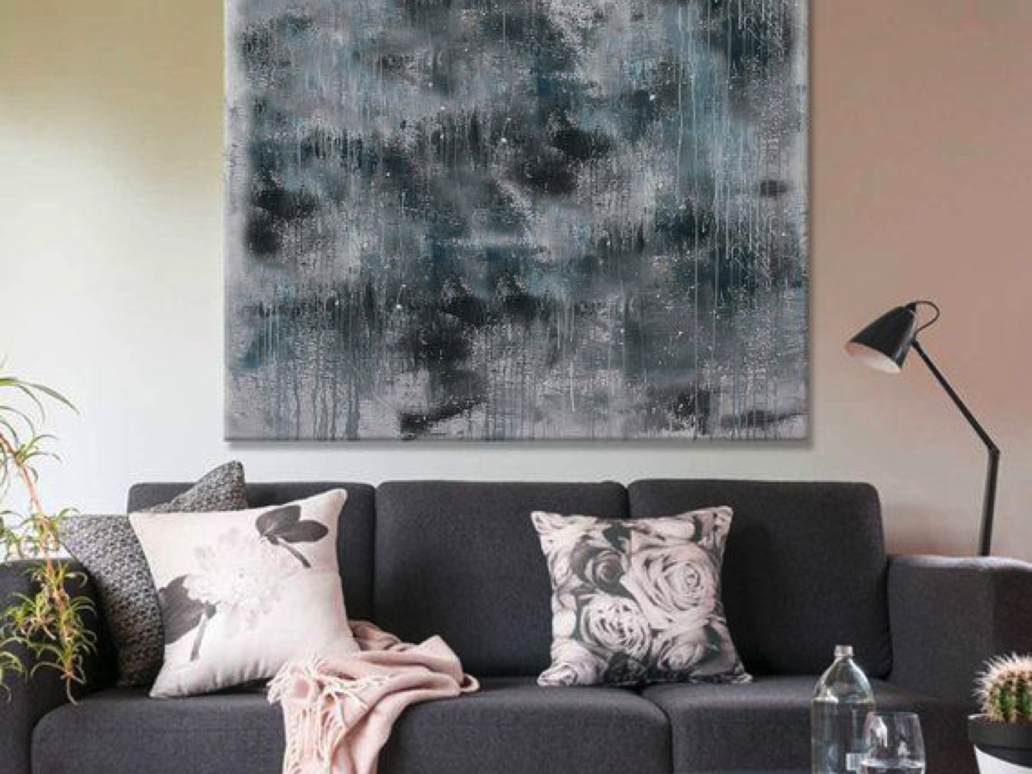
7872 Aroosa Khan Module: 1 Summative Assessment Task: A

Slide 2
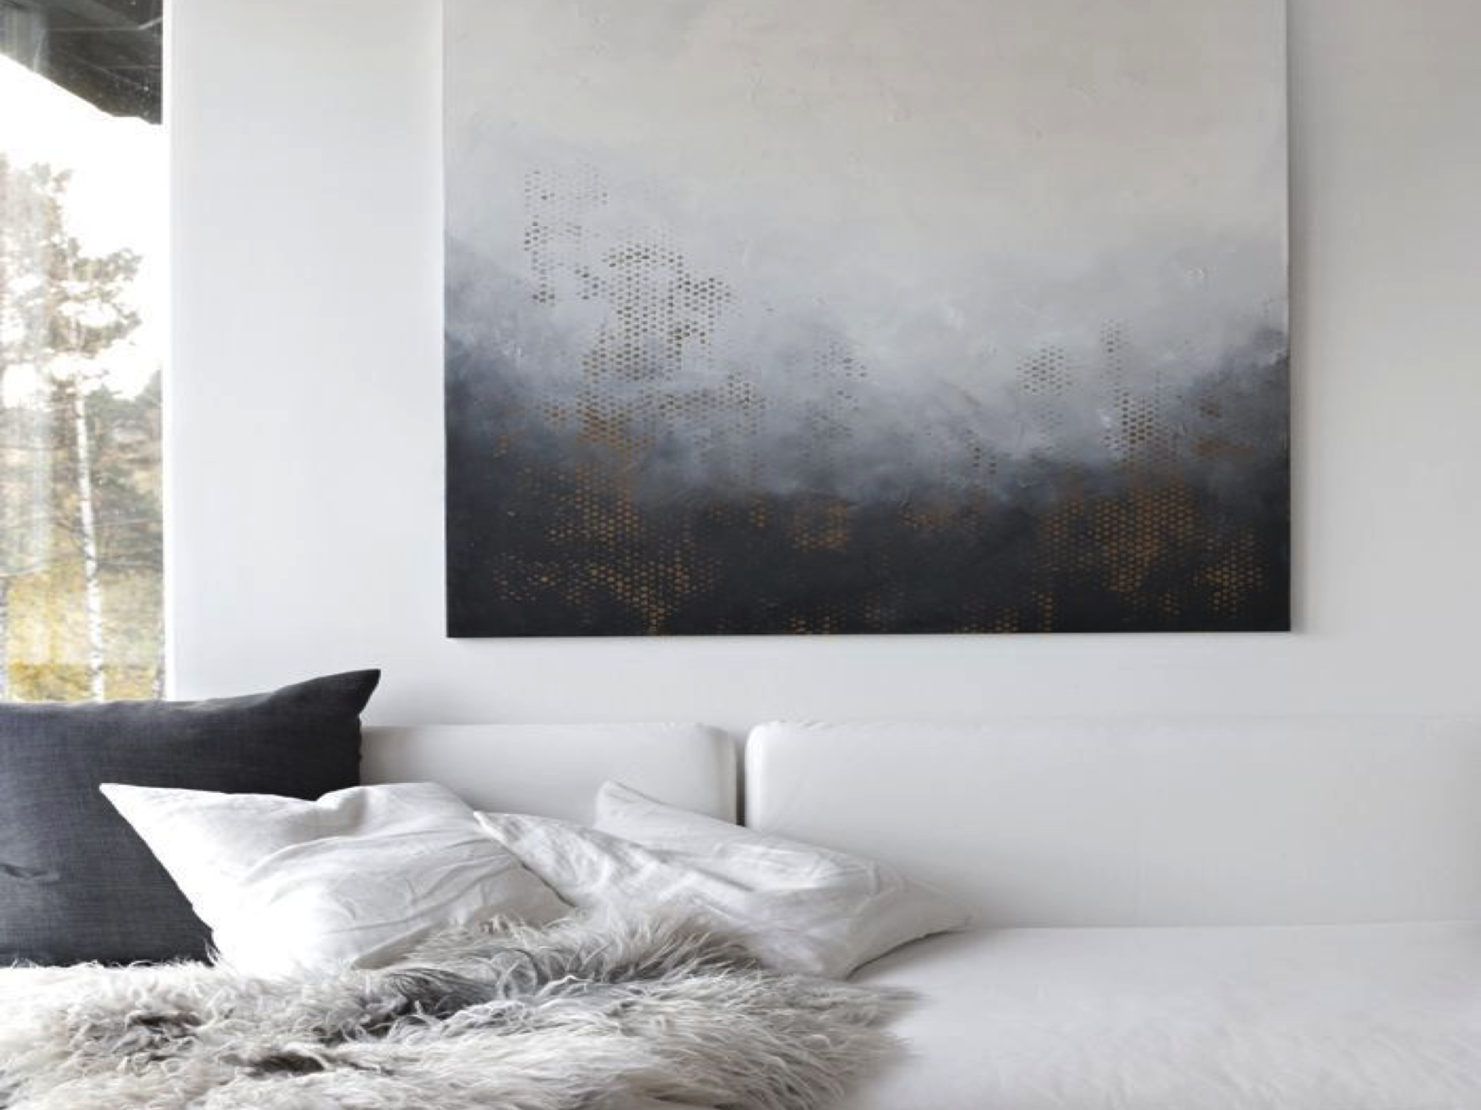
Table Of Contents
Form
Space
Light
Color
Texture
Furniture
Objects
References

Slide 3

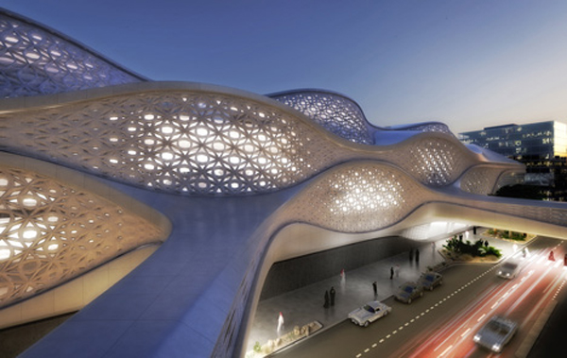
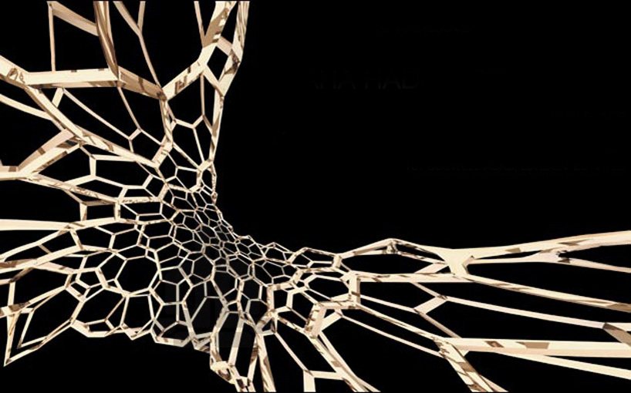
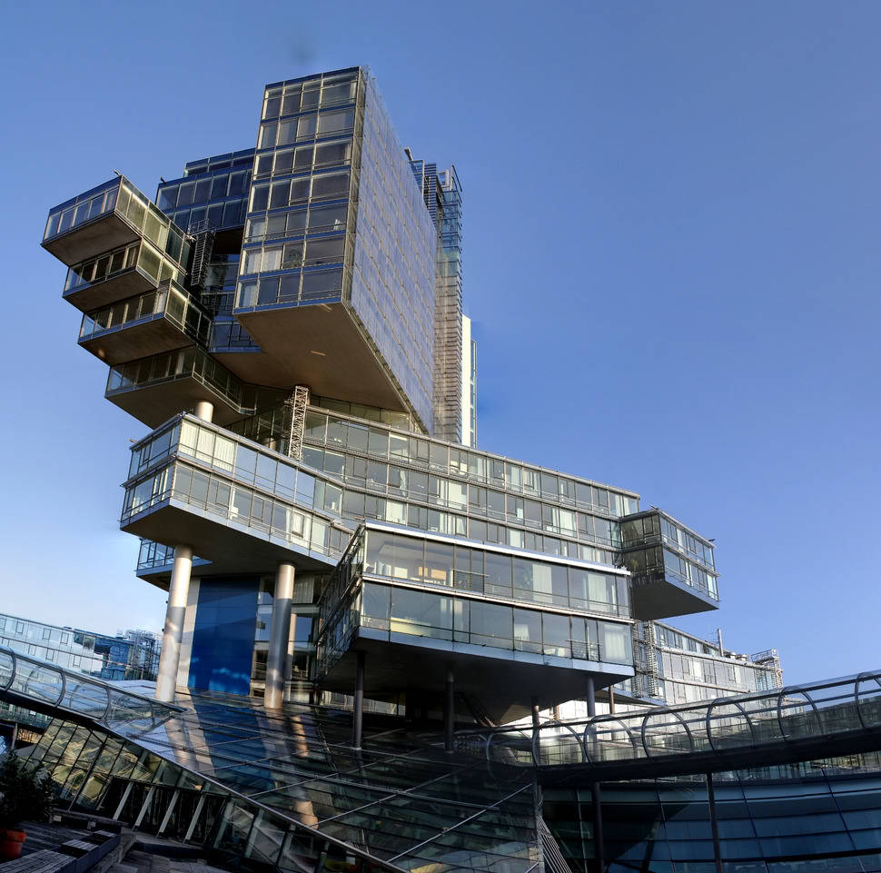
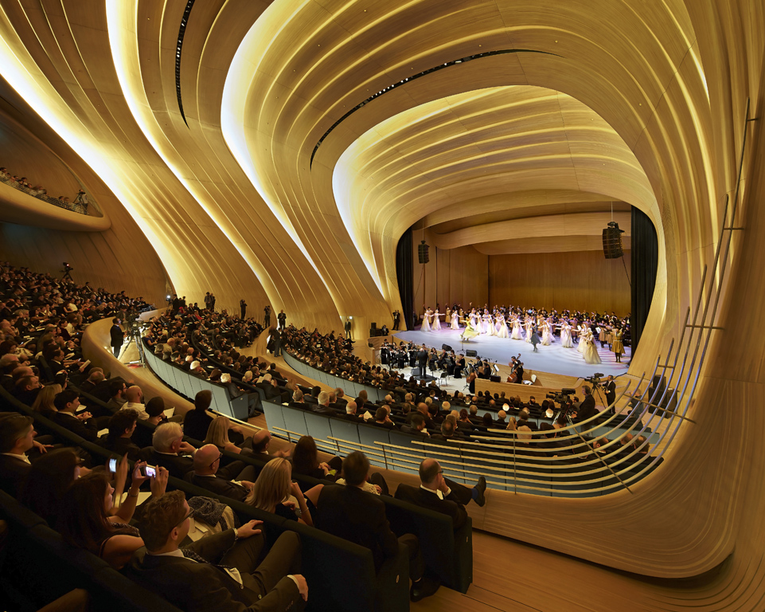
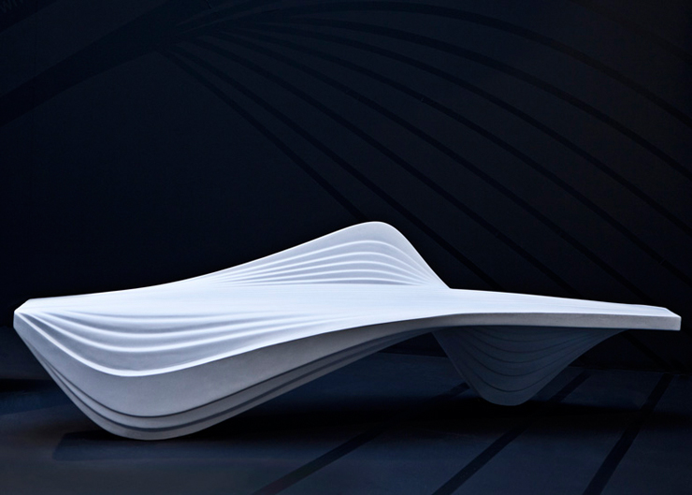
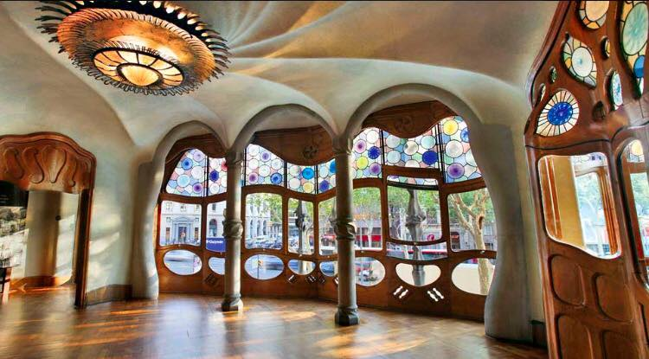
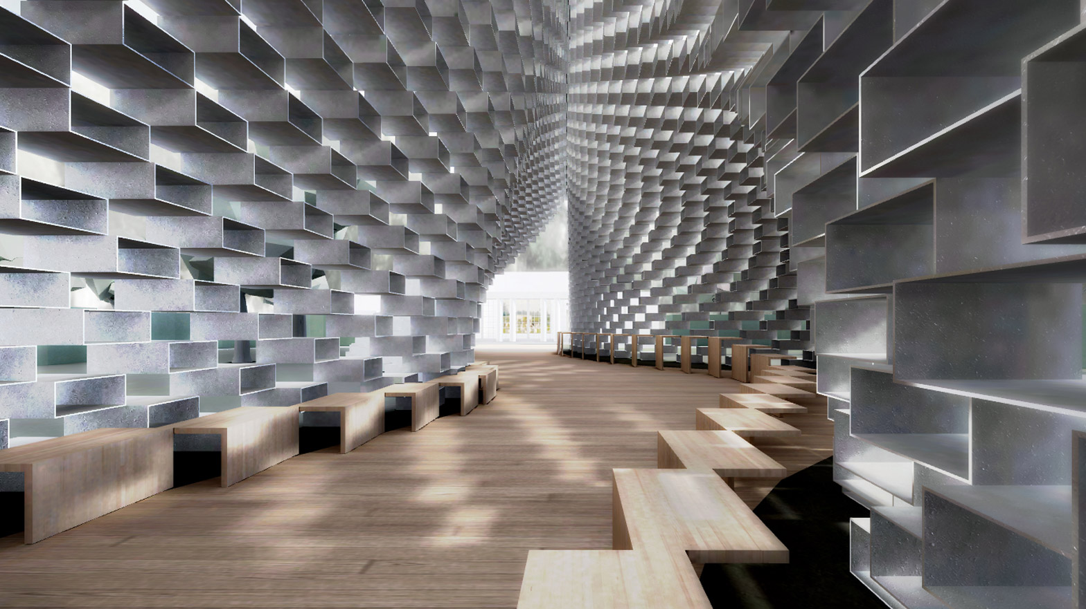
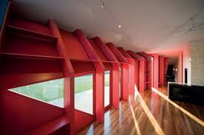
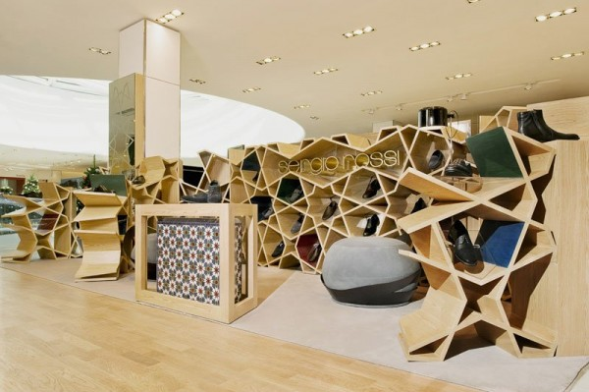
Form

Slide 4
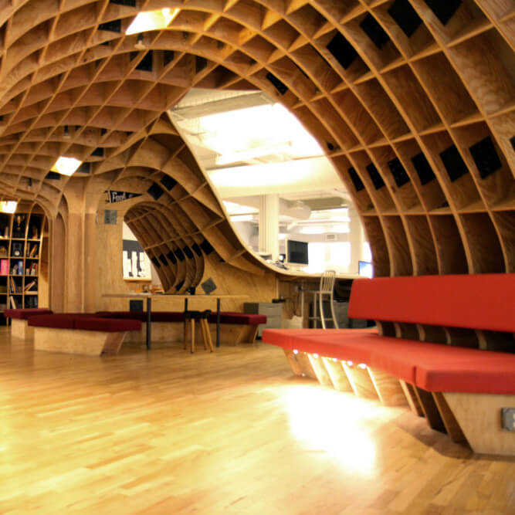
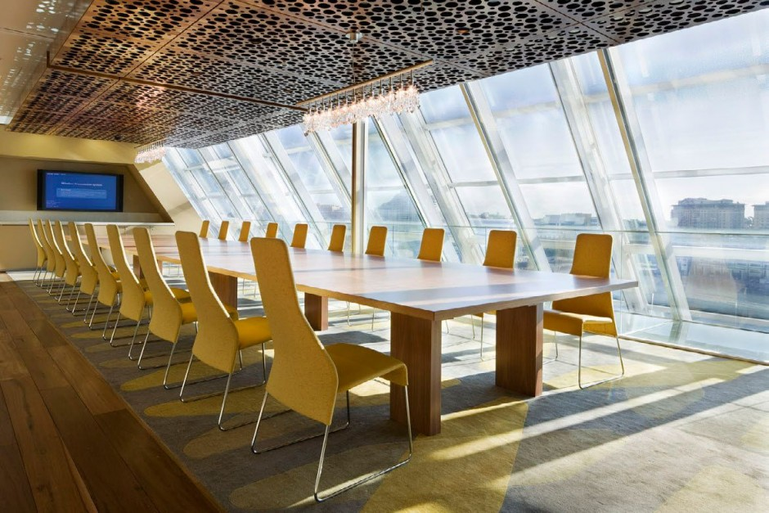
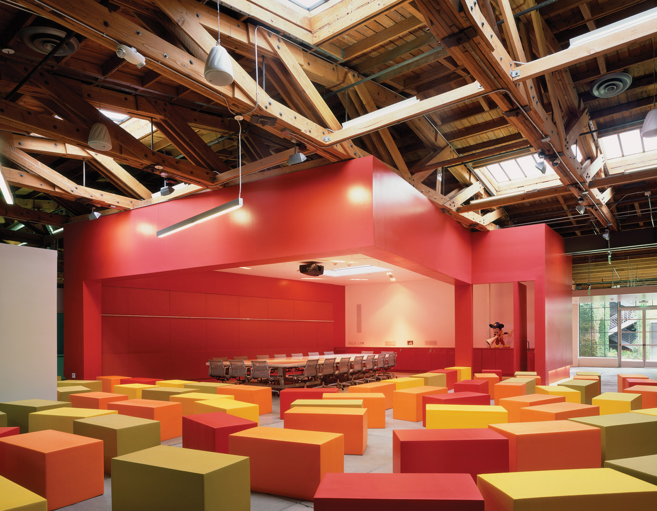
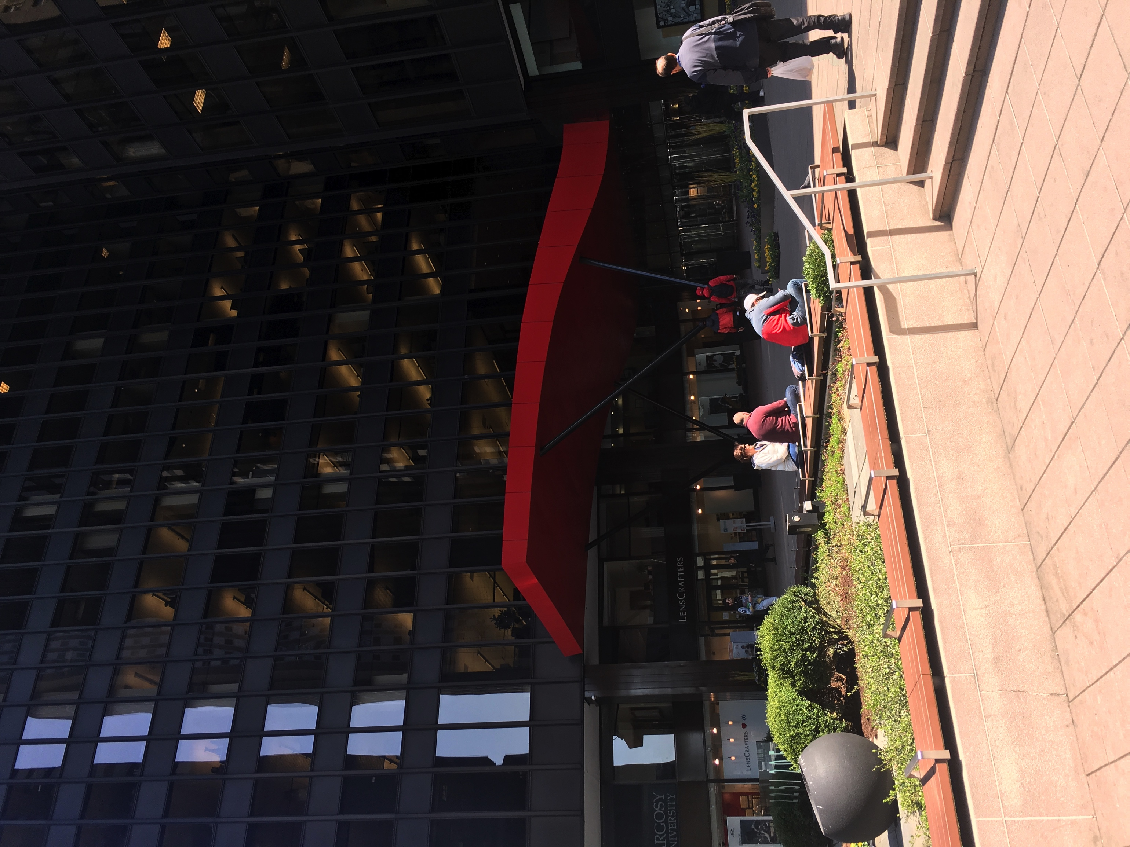
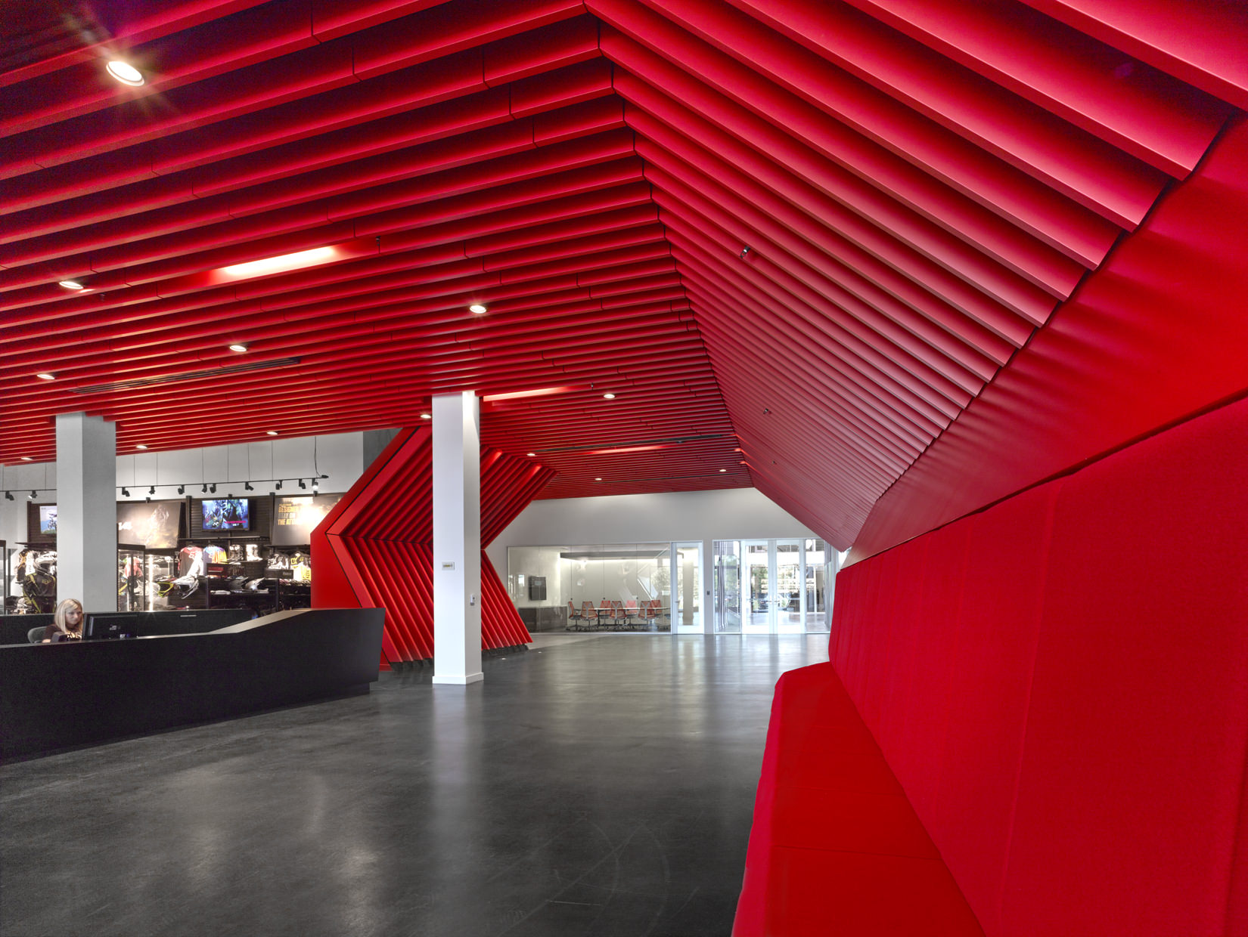
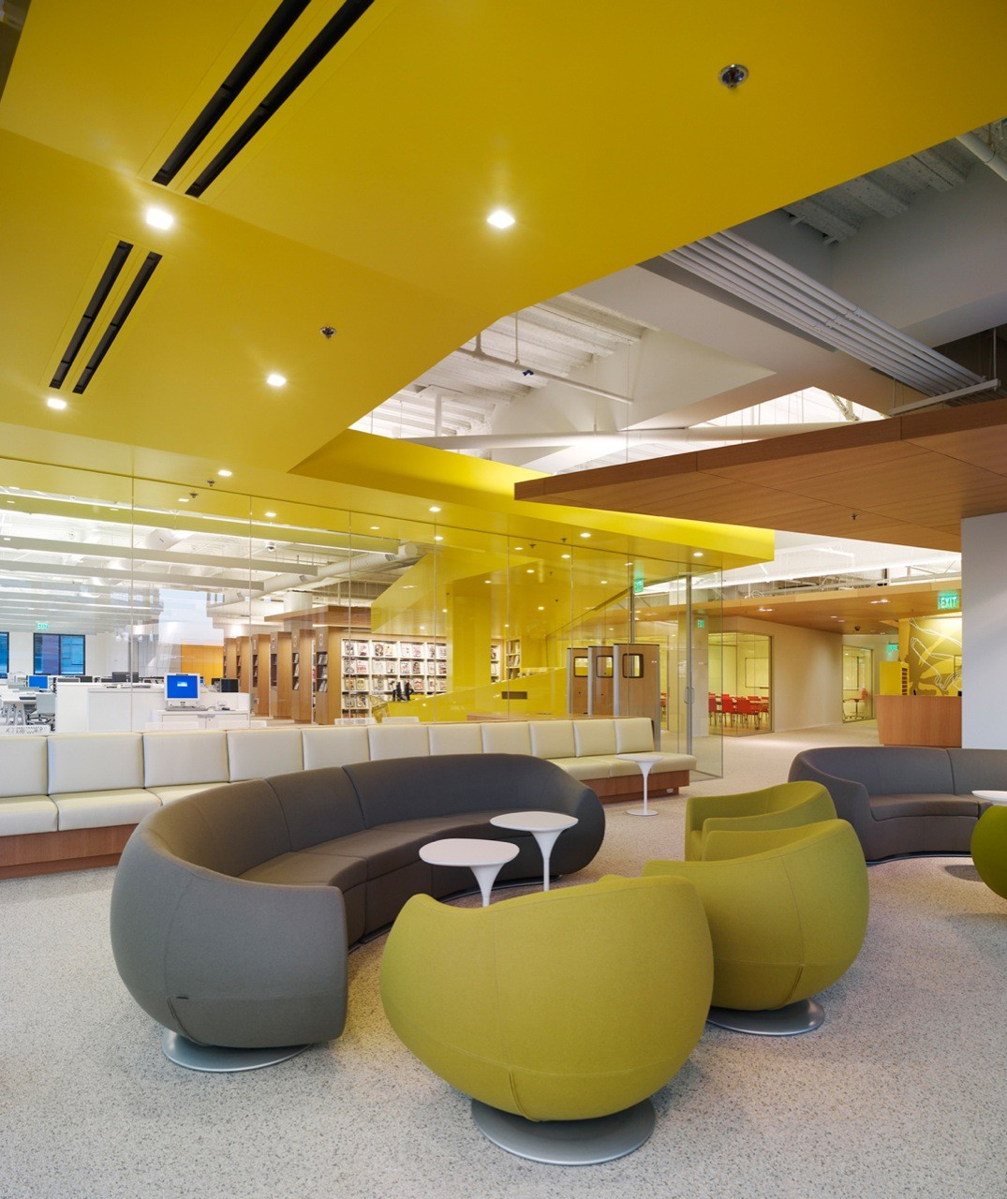
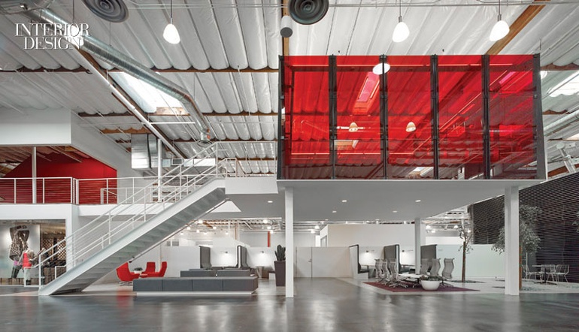
Space
Space is carried within barriers and limits the operative and ornamental innovations which are attainable within a space.
The picture depicts a well planned use of the compact area. (Wilkinson 2012). The scarcity of space is utilized by high stairs while still benefiting from the room underneath it by placing a sofa. High ceilings allow a sense of openness to be felt in a fairly smaller area.
In the shown Fox Global Headquarters (Wilkinson 2012) , the ceiling is not parallel to the floor which makes the area look much palatial. Th lack of pillars allow the floor to map out a much larger surface area. The roof helps emulsify a widening sense of the room.
The use of compact space can be readily noticed in this photograph I took in Chicago. Space is put to good use in this building by creating an attractive shed over the entrance.

Slide 5
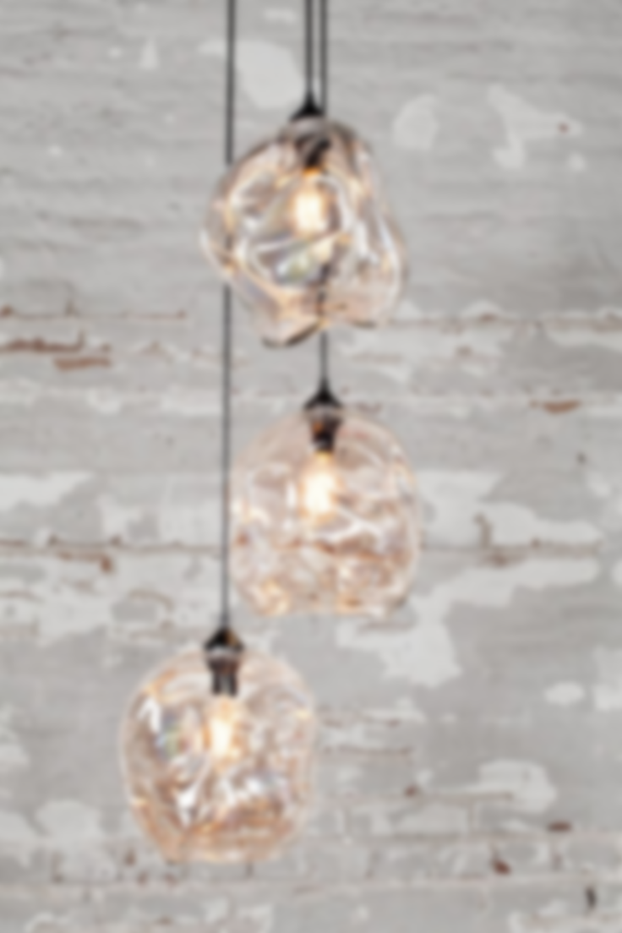
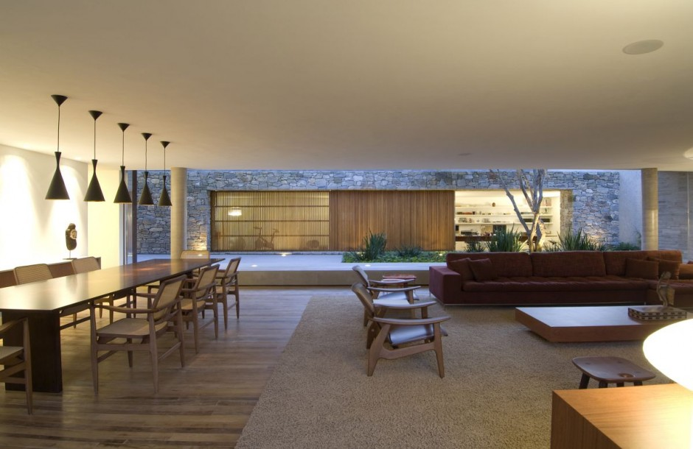
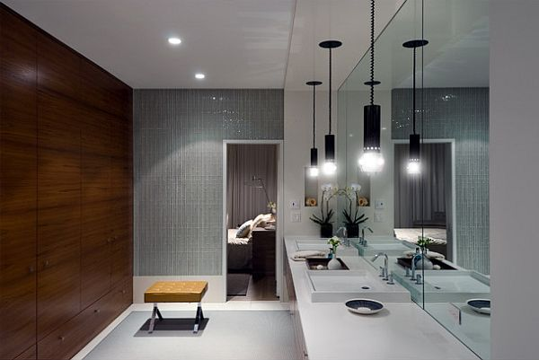
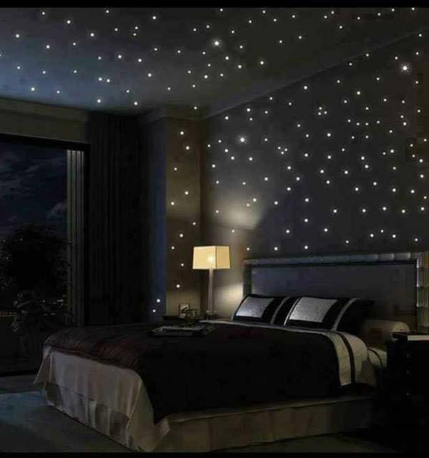
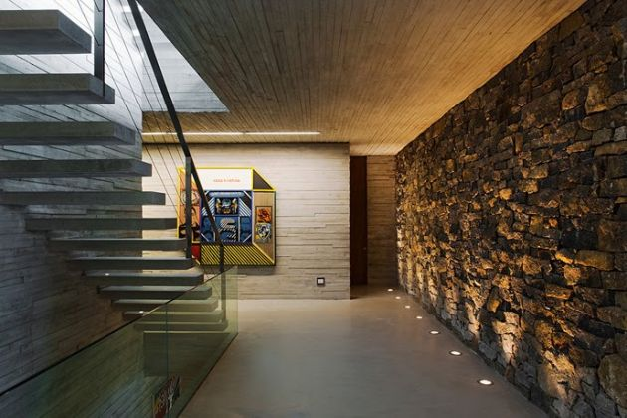
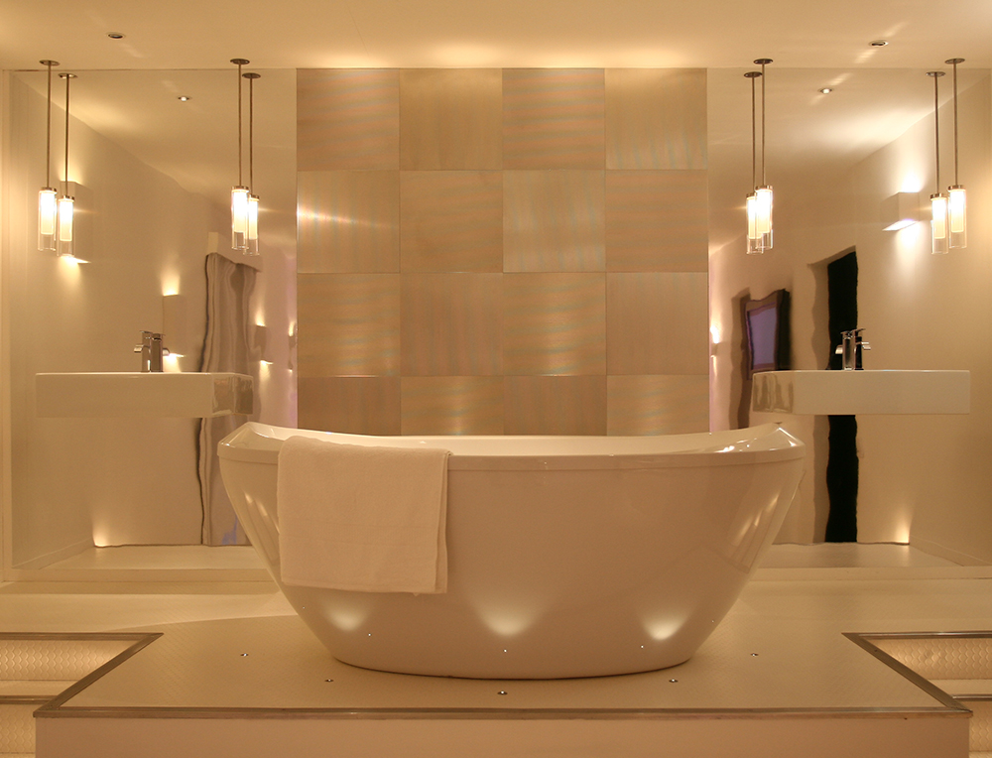
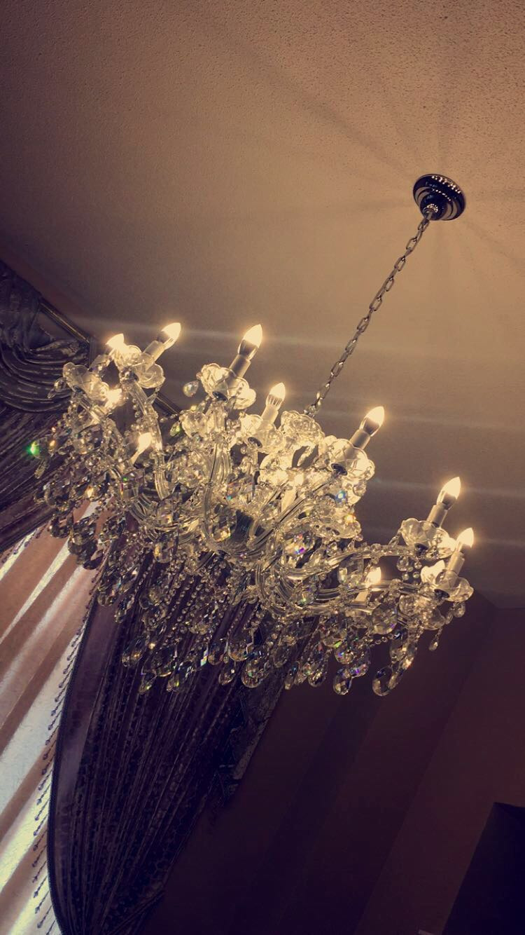
Light
Lighting has a dramatic affect on the mood and atmosphere of an interior space. (Makoid, 2017)
The aligned table pendant lamps spotlights the dining table, making it the highlight of the room. A full side wall made out of glass draws outdoor lighting to contrast in with the indoor lighting. A small table lamp placed on the table, even in one of the corners of the room, helps provide soothing lighting feel to the whole room. (Kogan, 2010)
The all-black theme of the room allows even the slightest of light to be personified at night. Although the star-like led lights over the walls and roof are not necessarily adding to the light provided by the side table in the room, they create an appeasing aroma on their own. (Clarida, 2017)
. The glassy marble reflects all light that hits its surface. Along with that, the huge mirror covering a whole side wall two folds the spacious and lighting sense of the bathroom. The pendant lighting intensifies light before shining it out to its crystal cylinder structure. (Cullen, 2015)

Slide 6
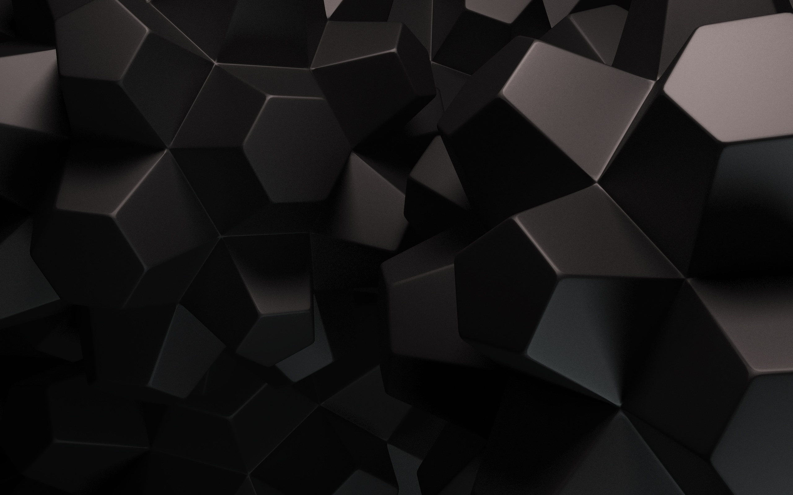
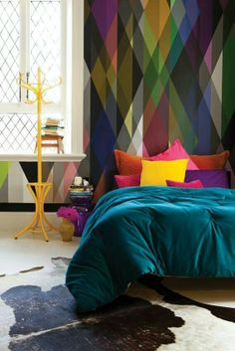
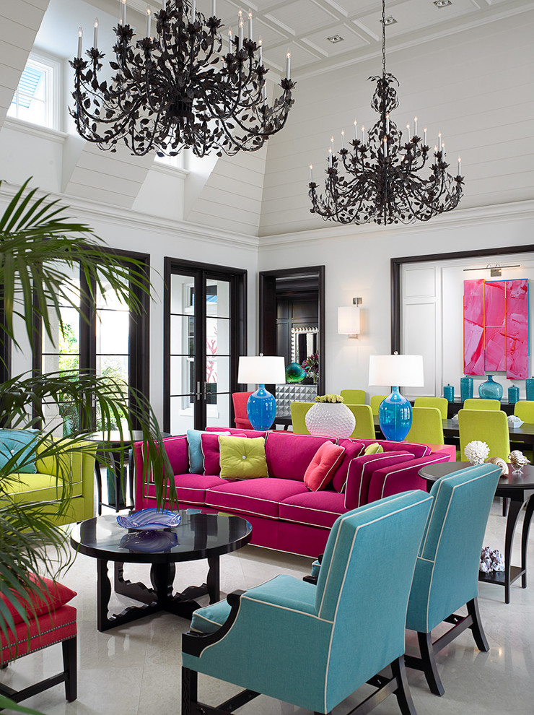
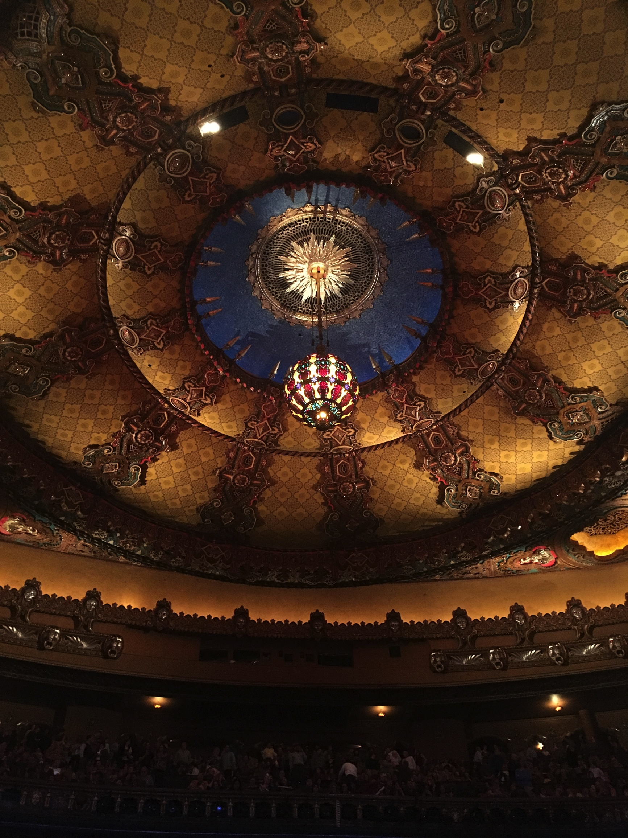
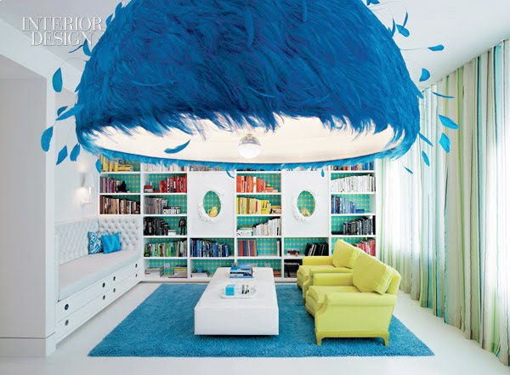
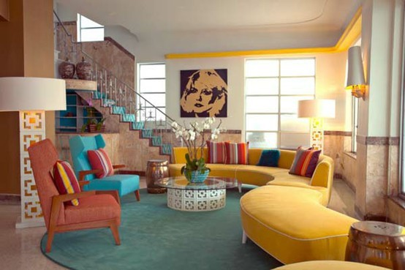
3
1
Color both affects and is affected by its surroundings and the colors in it, also by the color of light that falls on it. (Clarida, 2017)
Color
The black and white theme of the walls, doors and chandeliers is balanced out by colorful set of lamps and sofas. The mixture of hues in the pillows makes them stand out from the sofas giving them a very subtle look. (Edison, 2013)
The themes throughout the room have been utilized in pairs. As we saw earlier, the sofas share their color with roof lining, the blue carpet extends above the staircase. The floor lamps and wall lamps are also colored in orange. This spread of hues gives the room a connected feel. (Fraccaroli, 2013)
In this room the accent wall is covered in patterned mix of colors resembling a graffiti. The bed next to it adapts the same theme and shows off bright colors. Due to such vibrant colors, the room glows even in just natural light. (Cole&Son, 2014)
A white theme goes well with any color especially vibrant ones. This room is not that spacious in size, but it’s use of white in all corners give it an open feel. The light blue color behind the bookshelf, carpet and in pillows adds the much soothing flavor needed. (Vinas, 2015)
The different shades in color at Fox Theater, Detroit are not built in but are an effect of the lighting used. The chandelier in the center attracts most attention as to being the source of the baroque pattern on the roof. The dimly lit roof soothes the mood and glows with calmness.
4
5
5
2

Slide 7

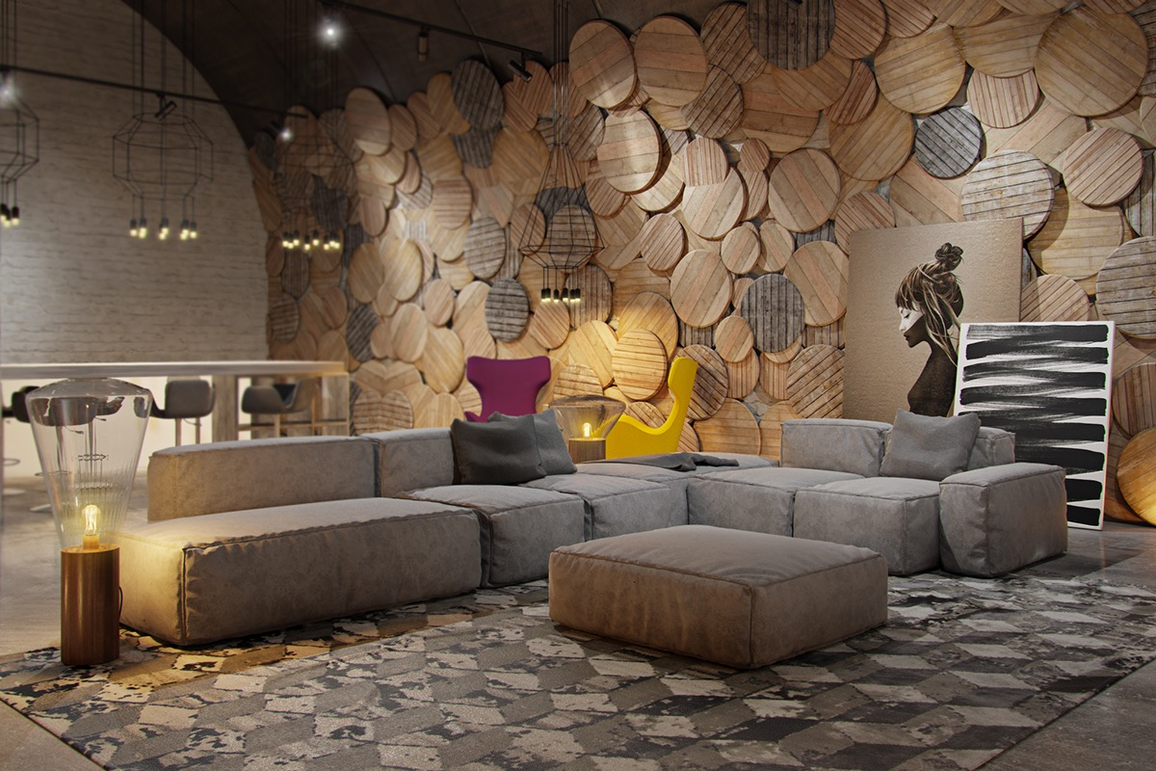
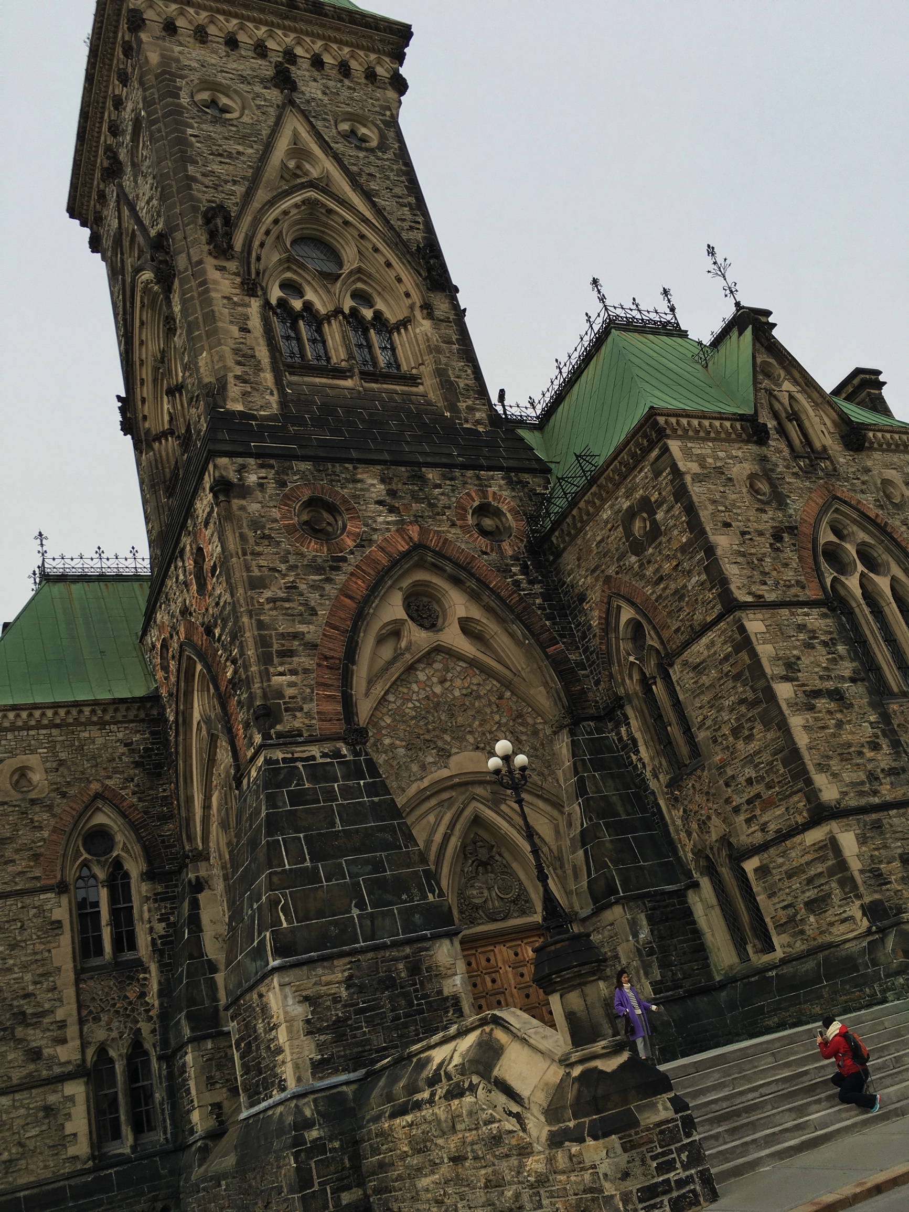
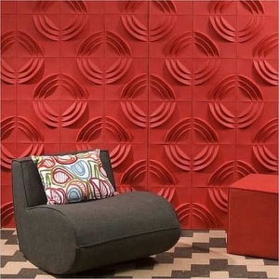
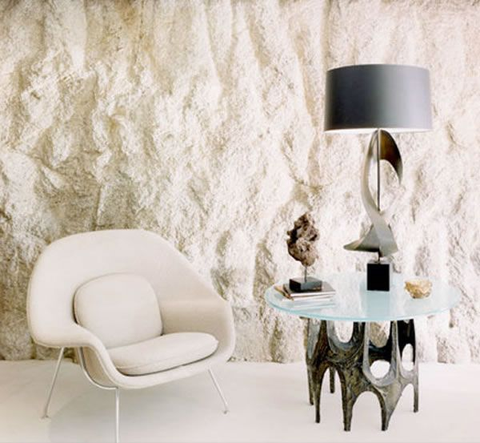
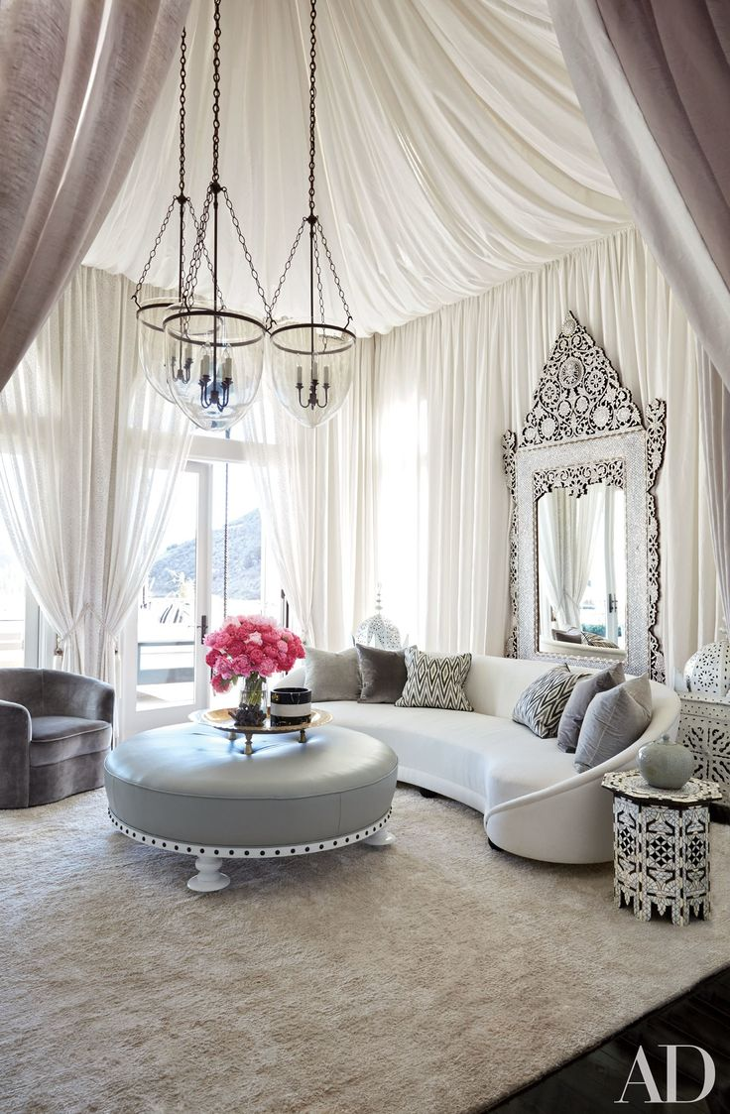
Texture describes the way a three-dimensional creation really feels when touched. Every surface has a texture; rough or smooth, matt or shiny, hard or soft.
Texture
This picture of Parlement du Canada I took shows that the texture has been chosen to out stand the color of the building itself. Requiring minimal color, the building catches attention greatly by its intrinsic complex nature of texture and an antique feel.

Slide 8

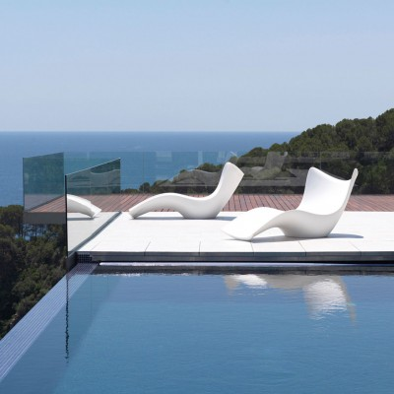
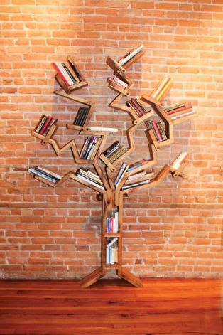
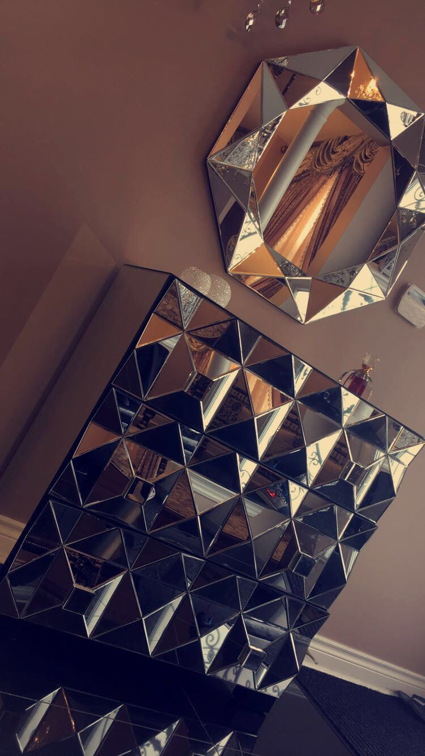
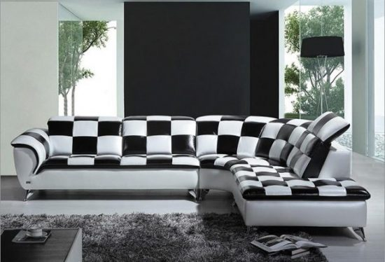
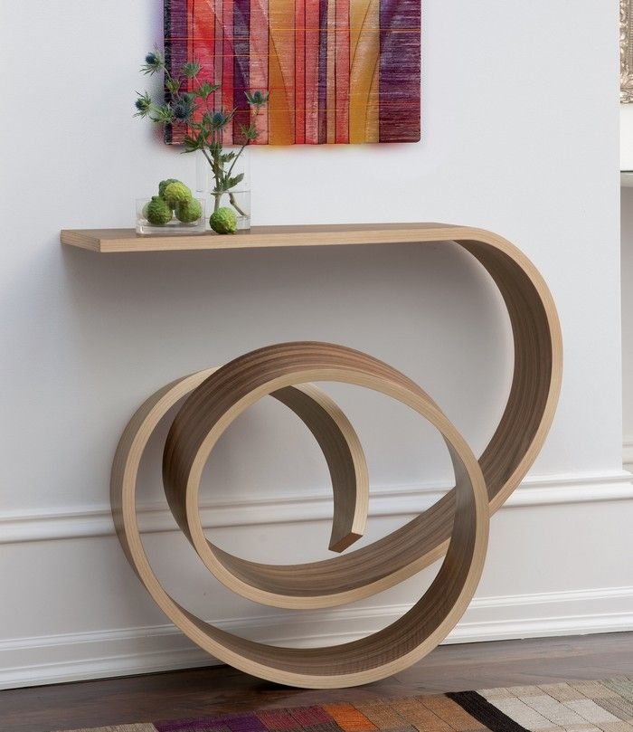
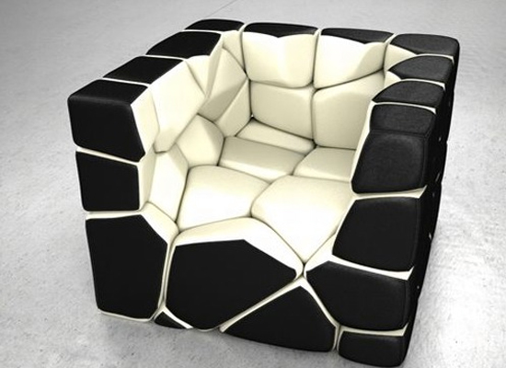
Furniture
“I like my furniture to be calming and not tense. Being functional and stylish at the same time” – Karim Rashid
Furniture can provide functionality to a room as well as contribute to the overall style and feel. Pieces of furniture not only add function and practicality to a space, but they also add style and personality
As we saw earlier, colored armchairs can add to the style theme of the interior while adding comfortable functionality

Slide 9
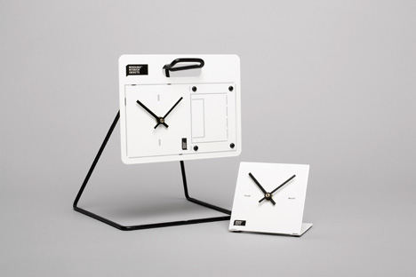
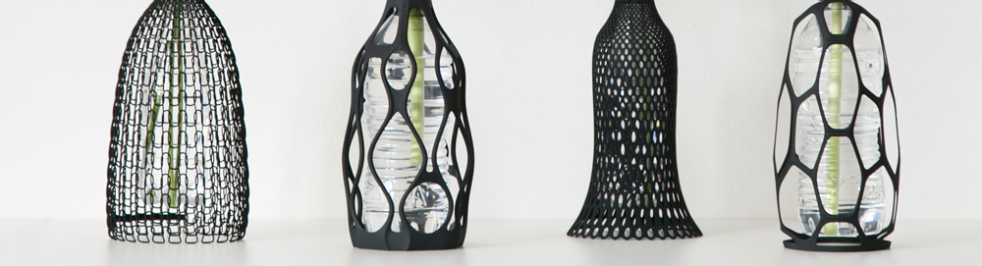
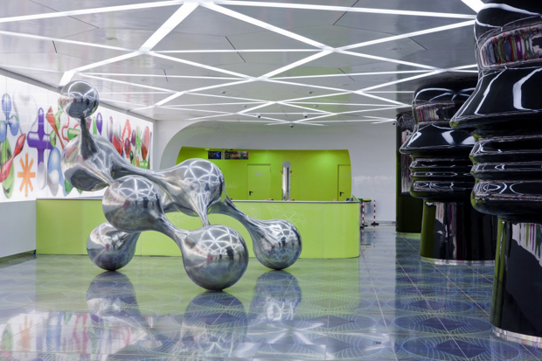
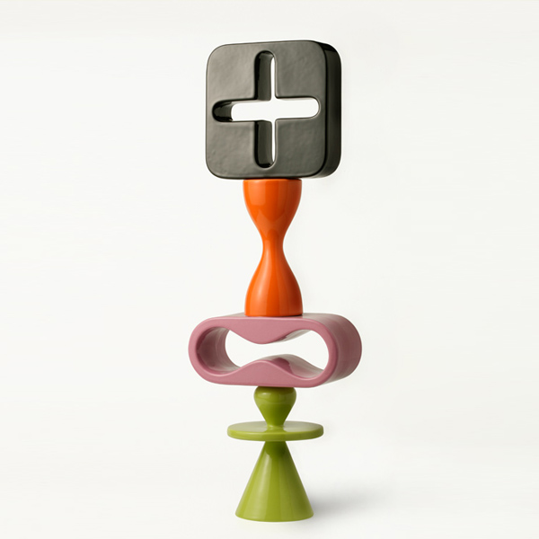
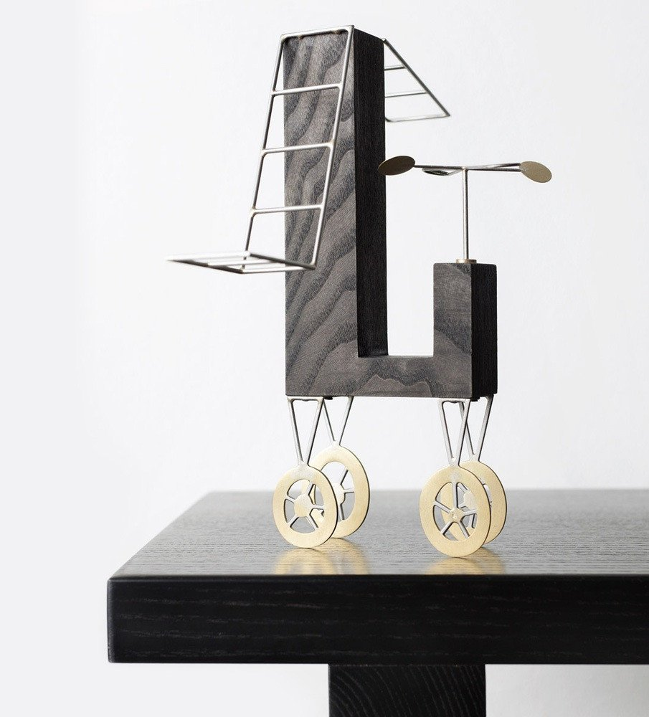
Objects are used to beautify and enhance the look of a certain area making it look more attractive. Objects add personality to a room and can help to clarify a design concept
(Rutilo, 2017)
Accessories can take any shape or form, that’s what makes them so captivating. From modern finds or personal creations to antique treasures.
Varying colors and textures should also be considered to create visual intrigue and a sense of variety.
Naples Universita Metro Station with Karim’s signature blobby 3D representations and his structure “The Seven Sins”
(Etherington, 2012)
Objects
“Objects do not have meaning. But if an object is thoughtful we project meaning onto it in daily life.”
– (Rashid, 2017)

